Slide 1

A review, a Brnich assessment and comparison with Findlay 2018

Slide 2
Background
Previously developed an assay system for the functional categorization of BRCA1 VUS (Bouwman, Peter, et al. "A high-throughput functional complementation assay for classification of BRCA1 missense variants." Cancer discovery 3.10 (2013): 1142-1155.)
The assay system is based on complementation of Brca1-deficient mouse embryonic stem (ES) cells by human BRCA1 cDNA variants.
Two hundred thirty-eight BRCA1 VUS were tested (used the LOVD BRCA1 database (2015) to select VUSs reported by the clinical genetic laboratories in the Netherlands and Belgium (https://databases.lovd.nl/shared/genes/BRCA1)

Slide 3
Background
Functional Tests were based on the ability to complement Brca1-deficient mouse embryonic stem cells in HRR
  Cisplatin sensitivity assays
  Olaparib sensitivity assays
  Direct repeat GFP (DR-GFP) HRR assay.
Validation: 25 known benign and 25 known pathogenic

Slide 4
Background
To investigate if these assays are able to detect deleterious VUS outside the RING and BRCT domains, 3 variants were included in the coiled-coil domain that are known to disrupt the interaction with PALB2 and attenuate HRR (BRCA1 c.4198A>G p.(Met1400Val), BRCA1 c.4220T>C p.(Leu1407Pro), and BRCA1 c.4232T>C p.(Met1411Thr)).
As functional data alone is insufficient for VUS classification, they have also collected and analysed available genetic and clinical data for deleterious VUS or VUS occurring in three or more Dutch or Belgian families.
In silico splice site prediction analysis was performed for all variants using Alamut

Slide 5
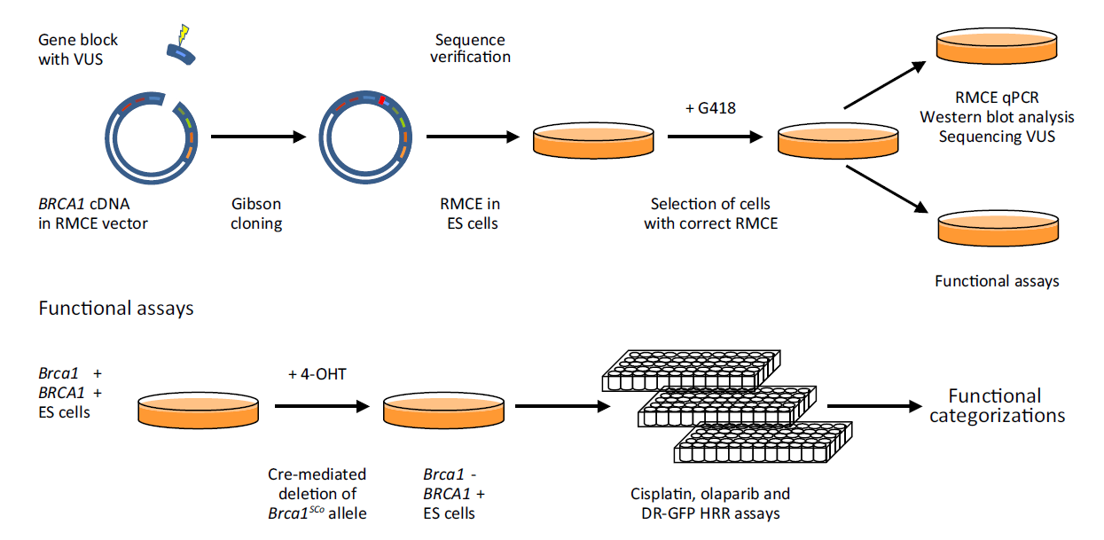
Using Quick-Change Lightning SDM, tandem AarI restriction sites were introduced to allow excision and replacement of eight consecutive segments of the human BRCA1 RMCE (Recombinase-Mediated Cassette Exchange) vector
NOTE: the RMCE vector contains 4 known benign SNPs c.2082C>T p.(Ser694Ser), c.3113A>G p.(Glu1038Gly), c.4308T>C p.(Ser1436Ser), and c.4837A>G p.(Ser1613Gly) (https://brcaexchange.org).
Notes:
Our previously described assay system (10) made use of SDM to introduce VUS in the BRCA1 cDNA sequence of an RMCE vector
Although this method worked sufficiently well before, the large size of the BRCA1 RMCE vector makes it relatively inefficient. In addition, when SDM is used, the complete BRCA1 cDNA needs to be sequence verified for absence of unwanted additional mutations
Therefore, we created modified BRCA1 RMCE vectors in which we could easily replace part of the BRCA1 cDNA sequence by a synthetic gene block containing a specific variant

Slide 6
Excised segments were replaced by blocks containing BRCA1 variants

Slide 7
The inserted gene blocks of
all BRCA1 RMCE vectors were sequence verified (variant and assembly boundaries)

Slide 8
Transfection
into Brca1SCo ES cells containing the DR-GFP reporter

Slide 9
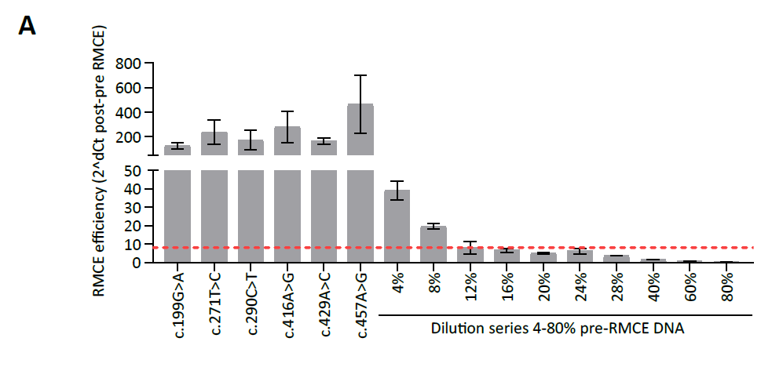
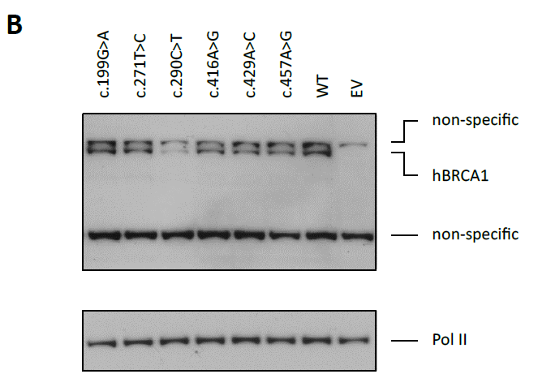
Before performing functional analyses, pools of transfected cells were assayed by qPCR for RMCE efficiency, human BRCA1 protein expression was confirmed by Western blotting, and the presence of the correct BRCA1 variant was verified using Sanger sequencing

Slide 10
Cells were thawed and cultured in batches with 17 to 21 VUS pools, with 3 independently transfected human BRCA1 wild-type and empty RMCE vector control pools per batch.
Mouse Brca1 was switched off using 1-day (at least 24 hours) 0.5 mmol/L 4-OHT incubation
Then cells were cultured for 3 days and seeded for cytotoxicity or DR-GFP HRR assays.
Three-day cisplatin and olaparib sensitivity assays were performed

Slide 11
For each series of experiments, data were normalized to three independently transfected wild-type human BRCA1 (WT) and empty RMCE vector (EV) controls.
All samples and controls were tested in biological triplicates.
Gaussian distributions were estimated for both the EV and WT controls.
These two distributions were used to calculate the posterior probability for a variant to be deleterious based on its mean-normalized IC50 or GFP percentage over the three biological replicates in the assay.
The VUS were categorized
  P > 0.99: deleterious
  0.95 < P ≤ 0.99: likely deleterious
  0.05 < P ≤ 0.95: intermediate
  0.01 < P ≤ 0.05: likely neutral
  P ≤ 0.01: neutral.
  Categorizations were considered uncertain in case the average values the SD over the biological repeats resulted in opposite outcomes [i.e., (likely) deleterious vs. (likely) benign].
Notes:
The half maximal inhibitory concentration (IC50)

Slide 12

Brnich 2020

Slide 13
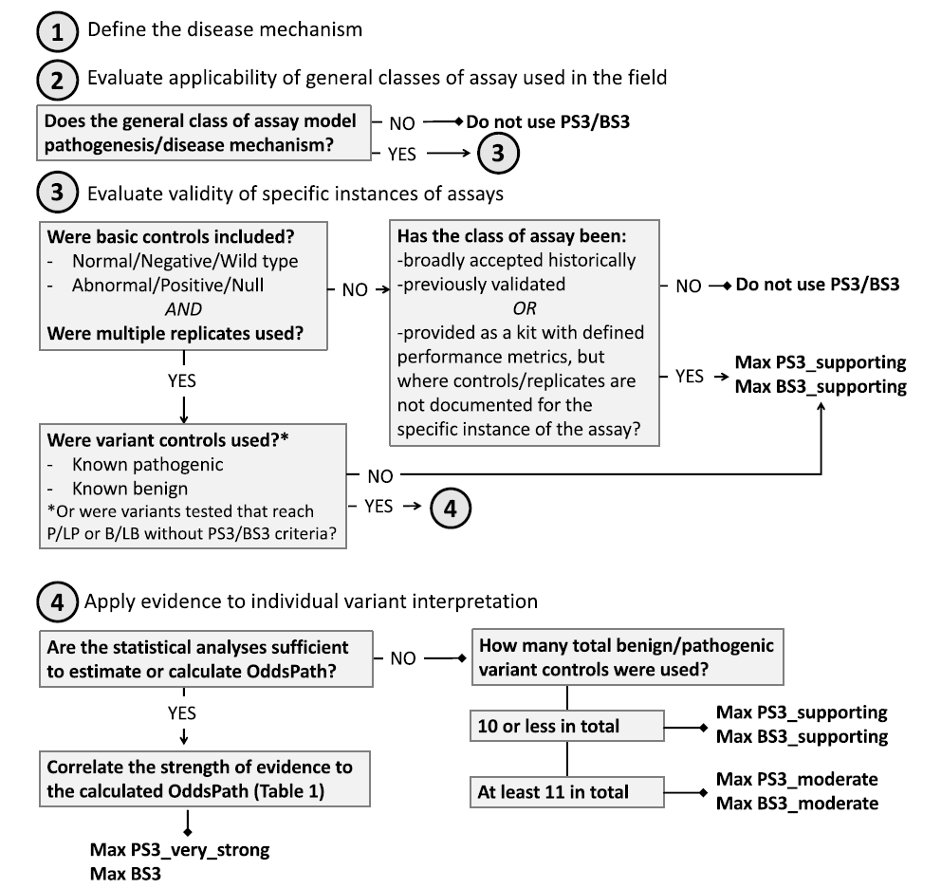

Brnich 2020

Slide 14
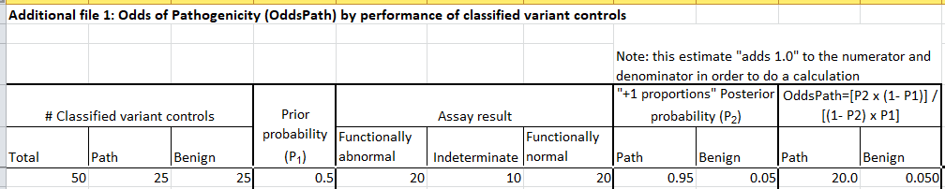
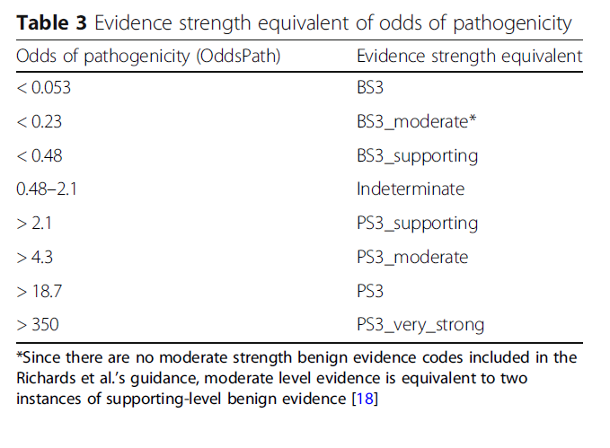
Brnich 2020

Slide 15
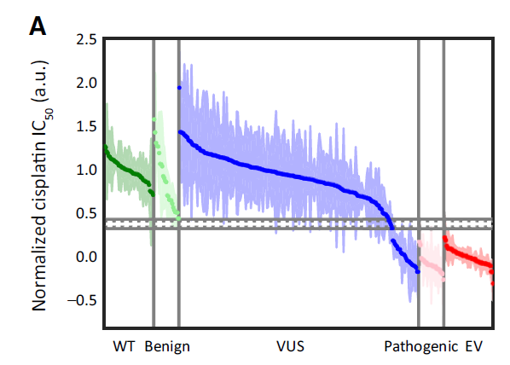
Cisplatin sensitivity assay
VUS Outcomes:
  205/238 – neutral and likely neutral
  1/238 – intermediate
  5/238 not clear
  27/238 deleterious
Validation set Outcomes:
  Benign: 25/25 neutral / likely neutral (1)
  Pathogenic: 25/25 deleterious
Notes:
For two additional VUS—c.5207T>C p.(Val1736Ala) and c.5348T>C p.(Met1783Thr)—the mean cisplatin response suggested functional defects, but these variants could not be categorized as neutral or deleterious because of experimental variation

Slide 16
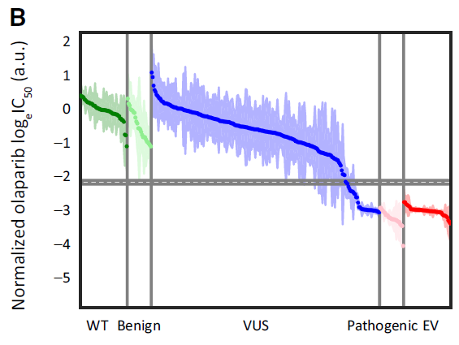
Olaprib Sensitivty assay
VUS Outcomes:
  189/238 – neutral and likely neutral
  1/238 – intermediate
  15/238 - not clear
  33/238 - deleterious
Validation set Outcomes:
  Benign: 25/25 neutral
  Pathogenic: 25/25 deleterious
Notes:
As we observed before (10), the differences in IC50 for the PARP inhibitor olaparib between neutral and deleterious variants were much more pronounced than for cisplatin
As the invariably low olaparib IC50 values for deleterious variants are accompanied by a large variation between repeat experiments for (partially) BRCA1-proficient variants, we used log-transformed olaparib IC50 values for functional categorization

Slide 17
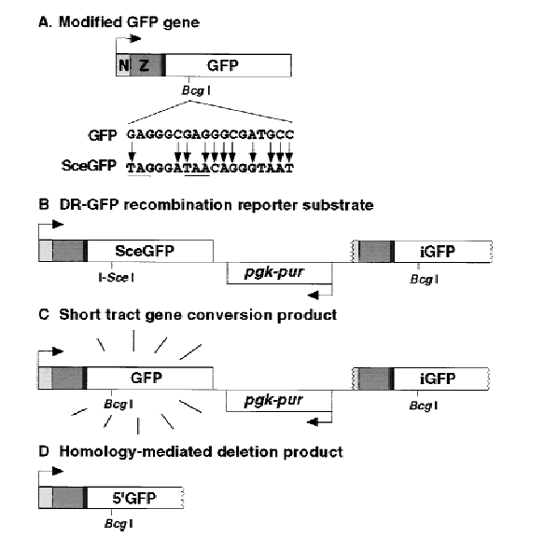
HRR assay
They used the “well-established DR-GFP reporter” to directly measure the effect of BRCA1 variants on HRR
This reporter expresses GFP upon HRR of a DNA double-strand break.
Pierce, Andrew J., et al. "XRCC3 promotes homology-directed repair of DNA damage in mammalian cells." Genes & development 13.20 (1999): 2633-2638.

Slide 18
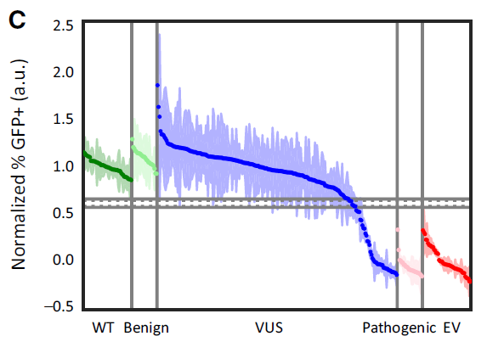
HRR assay
Validation set Outcomes:
  Benign: 25/25 neutral
  Pathogenic: 25/25 deleterious
VUS Outcomes:
  184/238 – neutral and likely neutral
  7/238 – intermediate
  2/238 not clear
  45/238 deleterious and likely deleterious

Slide 19
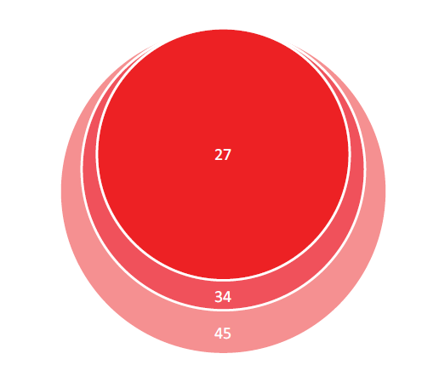
HRR assay
all variants identified as deleterious in the cisplatin or olaparib assays resulted in defective HRR
There were 11 variants which only scored as (likely) deleterious in the DR-GFP assay: c.41T>C, c.4220T>C, c.4232T>C, c.5002T>C, c.5062G>C, c.5071A>G, c.5074G>A, c.5128G>A, c.5225A>G, c.5300G>C, and c.5435C>G.

Slide 20
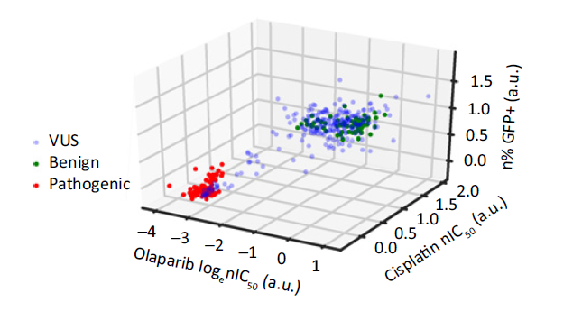
The 3 assays
In total, they analyzed 238 BRCA1 VUS and identified functional defects in 45 of them, 43 VUS in the RING and BRCT domains and 2 in the coiled-coil domain
With all 25 known pathogenic variants and all 25 known benign variants correctly categorized in the cisplatin, olaparib, and DR-GFP HRR assays, each assay has a sensitivity and specificity of 100%

Slide 21
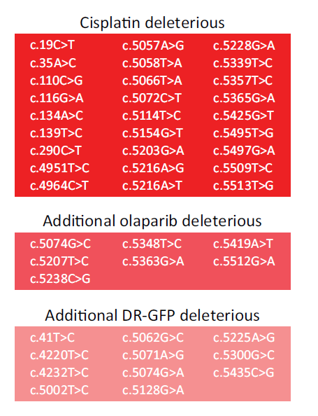
The 3 assays
Although the results of the 3 assays were highly concordant, a subset of variants was only scored as deleterious in the olaparib and/or DR-GFP assays
In most cases, these variants appear to be hypomorphic, conferring partial defects which were only significant in the HRR assay
Interestingly, and in line with their previous observations (Bouwman et al 2013), the coiled-coil variants c.4220T>C p.(Leu1407Pro) and c.4232T>C p.(Met1411Thr) only affect HRR and have no significant effect on the (short-term) drug sensitivities of the complemented ES cells
(Bouwman, Peter, et al. "A high-throughput functional complementation assay for classification of BRCA1 missense variants." Cancer discovery 3.10 (2013): 1142-1155.)
Notes:
In contrast to deleterious RING or BRCT variants, both deleterious coiled-coil variants are also able to support proliferation when mouse Brca1 is switched off (ref. 10; Supplementary Fig. S5A). These data indicate that the proliferation defect and drug sensitivity of BRCA1-deficient mouse ES cells are not caused by a defect in the completion of HRR per se.

Slide 22
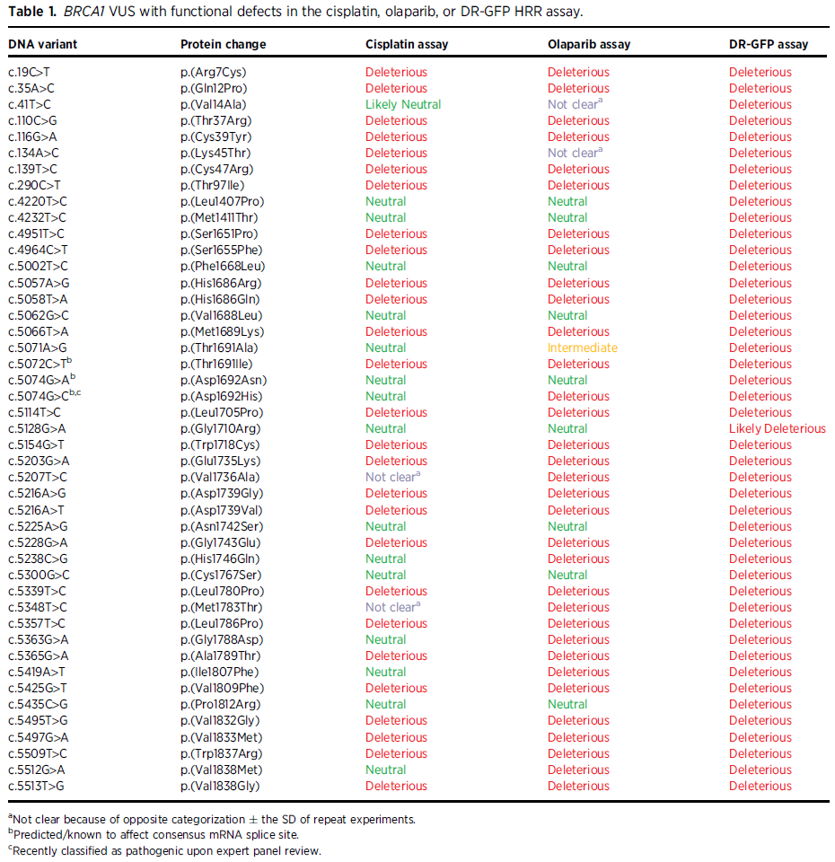
Notes:
In contrast to deleterious RING or BRCT variants, both deleterious coiled-coil variants are also able to support proliferation when mouse Brca1 is switched off (ref. 10; Supplementary Fig. S5A). These data indicate that the proliferation defect and drug sensitivity of BRCA1-deficient mouse ES cells are not caused by a defect in the completion of HRR per se.

Slide 23
Vs Findlay 2018 (HAP1 screen)
Ten discrepant cases may largely be attributed to a partial or intermediate loss of function that is only detected in the olaparib and/or DR-GFP assay(s)”
Two variants show opposite categorization in all three of our assays compared to the HAP1 screen. Variant c.19C>T p.(Arg7Cys) appeared to have no effect on HAP1 proliferation, but was defective in all three of our assays. For c.5258G>C p.(Arg1753Thr), we noticed the opposite.
Also in these cases, it seems likely that the variants have intermediate defects, that may vary depending on cell type or assay specific factors

Slide 24
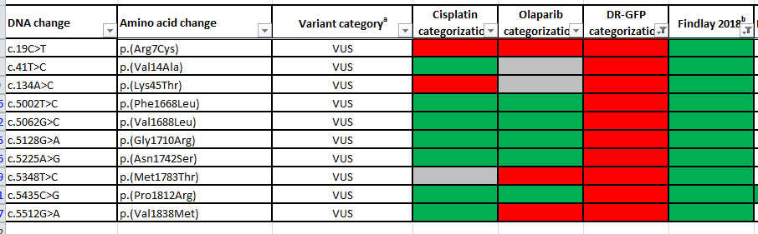
Comparison with other functional assays
“Ten discrepant cases may largely be attributed to a partial or intermediate loss of function that is only detected in the olaparib and/or DR-GFP assay(s)”

Slide 25
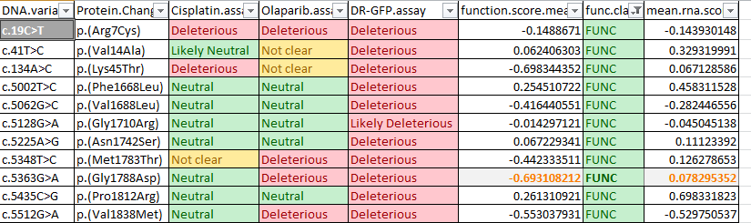
Comparison with other functional assays
Notes:
11 discrepant

Slide 26
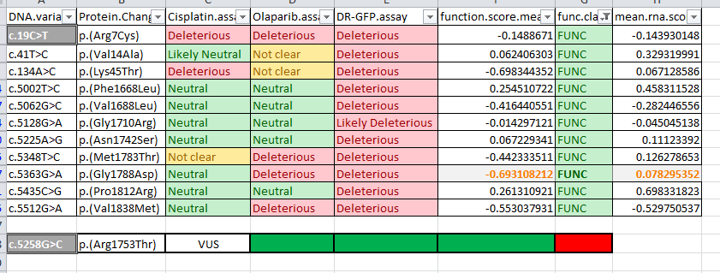
Comparison with other functional assays
Two variants show opposite categorization in all three of our assays compared to the HAP1 screen. Variant c.19C>T p.(Arg7Cys) appeared to have no effect on HAP1 proliferation, but was defective in all three of our assays. For c.5258G>C p.(Arg1753Thr), we noticed the opposite.
Also in these cases, it seems likely that the variants have intermediate defects, that may vary depending on cell type or assay specific factors
Notes:
12 differences

Slide 27
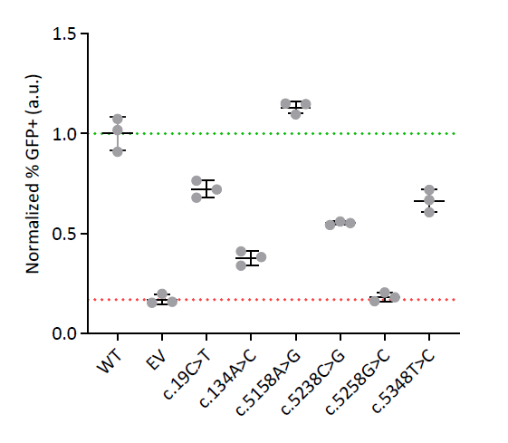
Comparison with other functional assays
Upon transient transfection of these VUS in the ES cell system, DR-GFP HRR activity was only mildly affected by c.19C>T, whereas c.5258G>C leads to a strong HRR defect (Supplementary Fig. S5B).
Cleary, there is a discrepancy between the results with stably integrated BRCA1 c.5258G>C versus transient expression, but sequence and Western blot analyses revealed no straightforward explanation (data not shown).

Slide 28
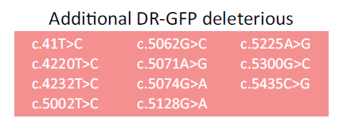
Comparison with other functional assays
The results of the HAP1 proliferation assay are highly concordant with those of our assays, with all overlapping 16 known pathogenic variants and 6 known benign variants categorized correctly
Interestingly, none of the 11 variants that were only identified as deleterious in the DR-GFP assay were picked up by the HAP1 proliferation screen. Of these, coiled-coil variants c.4220T>C and c.4232T>C were not included in the analysis

Slide 29
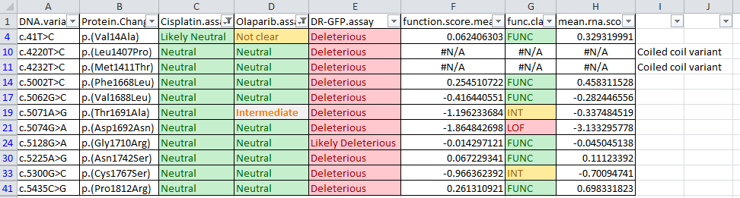
Comparison with other functional assays

Slide 30
VUS classification based on genetic and clinical data
Collected genetic and clinical data for VUS shown to impair protein function in the functional assays and VUS that had been observed in at least three families
In total, they collected data for 35 variants from 98 families. The recent publication of a large-scale multifactorial likelihood analysis of BRCA1 and BRCA2 VUS by the ENIGMA consortium (Parsons et al 2019) allowed us to add information for 18 of these variants
Parsons MT, Tudini E, Li H, Hahnen E, Wappenschmidt B, Feliubadalo L, et al. Large scale multifactorial likelihood quantitative analysis of BRCA1 and BRCA2 variants: An ENIGMA resource to support clinical variant classification. Hum Mutat 2019;40:1557–78.

Slide 31
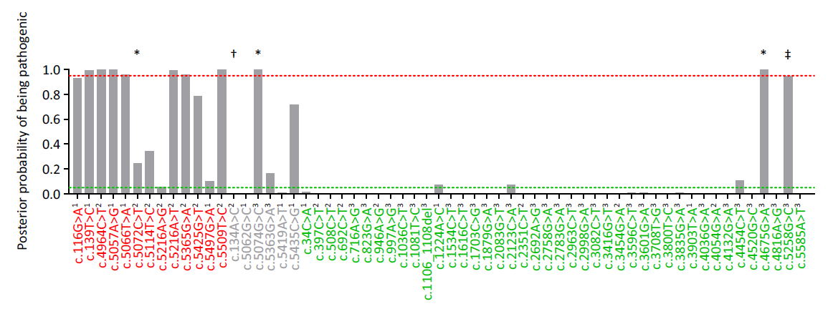
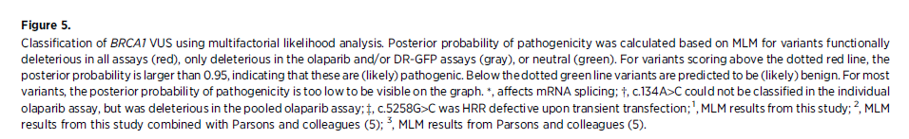
VUS classification based on genetic and clinical data
N/A
LOF
LOF
LOF
LOF
LOF
LOF
LOF
LOF
SGE outcomes
LOF
LOF
N/A
FUNC
LOF
LOF
LOF
FUNC
LOF
FUNC
FUNC
INT
Deleterious 3 assays
Deleterious Olaprib &/or DR-GFP
Neutral

Slide 32
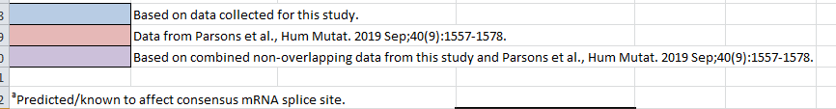
Pathogenic based on genetic and clinical data

Slide 33
Benign based on genetic and clinical data

Slide 34
Thirty-seven out of the 40 variants classified as (likely) benign were functionally neutral in all three of our assays. For three likely benign variants, the functional categorization was not consistent for the three assays.
Benign based on genetic and clinical data

Slide 35
Bouwman, Findlay and Genetic/Clinical classes

Slide 36
Discussion – discrepancies
What do we do with the 11 variants only shown to be non Functional by DR-GFP assay?
Notes:
Do we say a total of 2/4?

Slide 37
SGE LOF
Notes:
In contrast to deleterious RING or BRCT variants, both deleterious coiled-coil variants are also able to support proliferation when mouse Brca1 is switched off (ref. 10; Supplementary Fig. S5A). These data indicate that the proliferation defect and drug sensitivity of BRCA1-deficient mouse ES cells are not caused by a defect in the completion of HRR per se.

Slide 38
SGE LOF
Notes:
In contrast to deleterious RING or BRCT variants, both deleterious coiled-coil variants are also able to support proliferation when mouse Brca1 is switched off (ref. 10; Supplementary Fig. S5A). These data indicate that the proliferation defect and drug sensitivity of BRCA1-deficient mouse ES cells are not caused by a defect in the completion of HRR per se.

Slide 39
Discussion
What do we do with the 5 variants non-functional in 2 or more Bouwman but Functional by SGE?

Slide 40
SGE FUNC
SGE LOF
SGE FUNC
SGE FUNC
SGE FUNC
Notes:
In contrast to deleterious RING or BRCT variants, both deleterious coiled-coil variants are also able to support proliferation when mouse Brca1 is switched off (ref. 10; Supplementary Fig. S5A). These data indicate that the proliferation defect and drug sensitivity of BRCA1-deficient mouse ES cells are not caused by a defect in the completion of HRR per se.

Slide 41
Discussion
Upon transient transfection of these VUS in our ES cell system, DR-GFP HRR activity was only mildly affected by c.19C>T, whereas c.5258G>C leads to a strong HRR defect (Supplementary Fig. S5B). Cleary, there is a discrepancy between the results with stably integrated BRCA1 c.5258G>C versus transient expression, but sequence and Western blot analyses revealed no straightforward explanation (data not shown).

Slide 42
?
Notes:
In contrast to deleterious RING or BRCT variants, both deleterious coiled-coil variants are also able to support proliferation when mouse Brca1 is switched off (ref. 10; Supplementary Fig. S5A). These data indicate that the proliferation defect and drug sensitivity of BRCA1-deficient mouse ES cells are not caused by a defect in the completion of HRR per se.

Slide 43
Discussion
Notes:
Do we say a total of 2/4?

Slide 44
?
FUNC SGE, Olap, Cis and Benign Parsons
Notes:
In contrast to deleterious RING or BRCT variants, both deleterious coiled-coil variants are also able to support proliferation when mouse Brca1 is switched off (ref. 10; Supplementary Fig. S5A). These data indicate that the proliferation defect and drug sensitivity of BRCA1-deficient mouse ES cells are not caused by a defect in the completion of HRR per se.

Slide 45
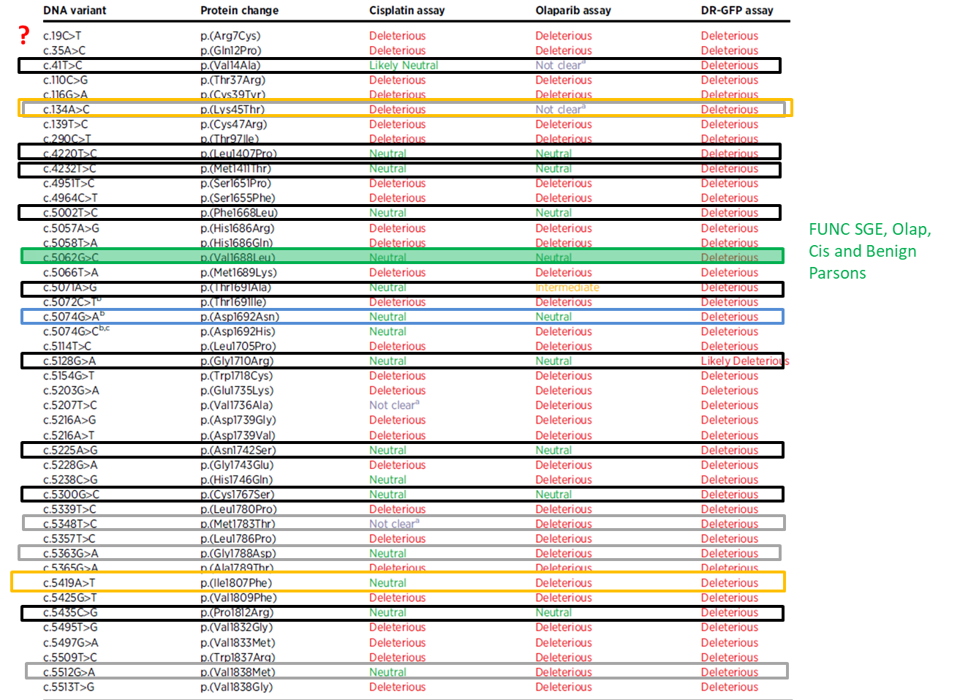
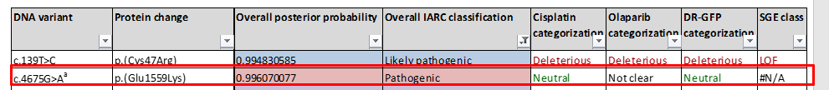
Notes:
In contrast to deleterious RING or BRCT variants, both deleterious coiled-coil variants are also able to support proliferation when mouse Brca1 is switched off (ref. 10; Supplementary Fig. S5A). These data indicate that the proliferation defect and drug sensitivity of BRCA1-deficient mouse ES cells are not caused by a defect in the completion of HRR per se.

Slide 46
Discussion
Well thought and excellent functional study
18 variants that are discrepant between some combination of these papers/functional assays (Bouwman, Parsons and Findlay)
Review them with CanVIG and PHE data
Reach a consensus for UK community
Notes:
Do we say a total of 2/4?

